Slide 1
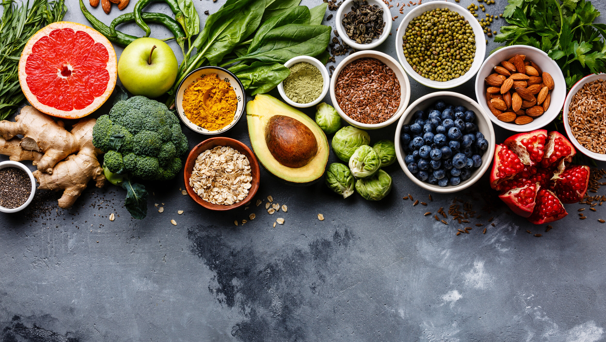
WELCOME
Caption

Slide 2

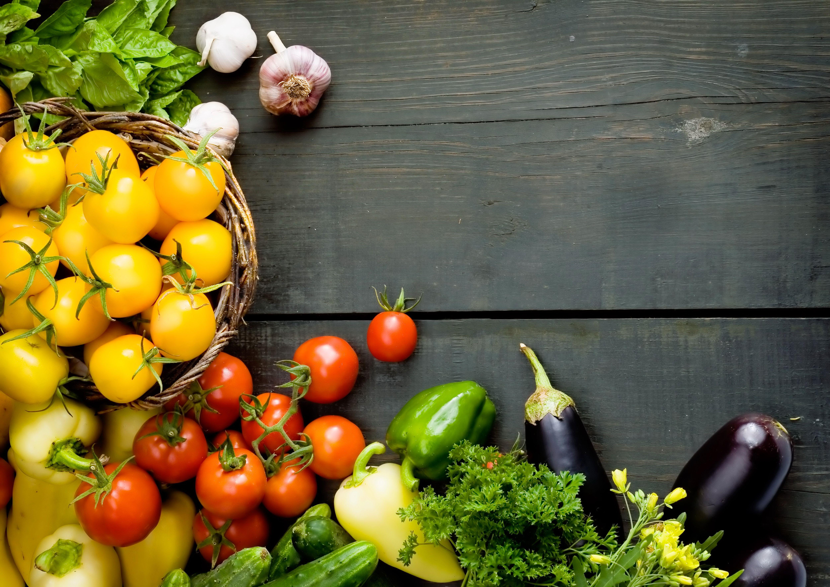
HeavyBite
Created by - Devesh

Slide 3
Topic
Problem Introduction - What is the problem with traditional offline ordering system?
Project Motivation, Objective and Scope
Some Previous Related Works
HeavyBite and it’s features
System Actors and Requirements
Tools Required
Data Flow Diagram(s) (DFDs)
Gantt chart
References

Slide 4
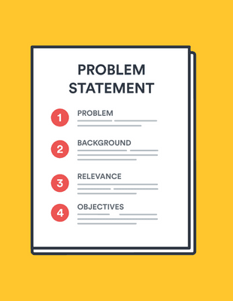
Why an online food ordering system?
Makes the ordering process easier :
Traditionally, people had to make calls to place orders or drive to the restaurants for a take-out, then wait for the food to be prepared and delivered. Sometimes, placing an order on the phone means that there could be mistakes in order.
2) Better Consumers Data : Who are your regular customers? What do they like ordering from your restaurant? Which food items are popular? Do they prefer ordering from a website or app? These and many other related questions can be answered using analytics and insights provided by a robust online ordering system for restaurants. This data is valuable since you can use it to send targeted promotions to your customers and entice them to keep coming back.

Slide 5

3) Efficient Customer and Order Management : An online ordering system for Restaurants helps enhance the customer-restaurant relationship by providing end to end Customer Relationship Management (CRM) system. It provides a complete sales dashboard with information about new/active/canceled orders, lifetime sales details, etc.
4) The convenience of mobile ordering : From meetings to crowded areas, there are times when one may not be able to make a phone call to order food. Online ordering allows customers to order anytime, anywhere using their mobiles, tablets or other handheld devices. There is no need for the customer to reach out and make a call meanwhile disturbing their privacy or disrupting a meeting for a lunch order.
5) Saves time of user Who doesn’t wanna save time? Time is money.

Slide 6
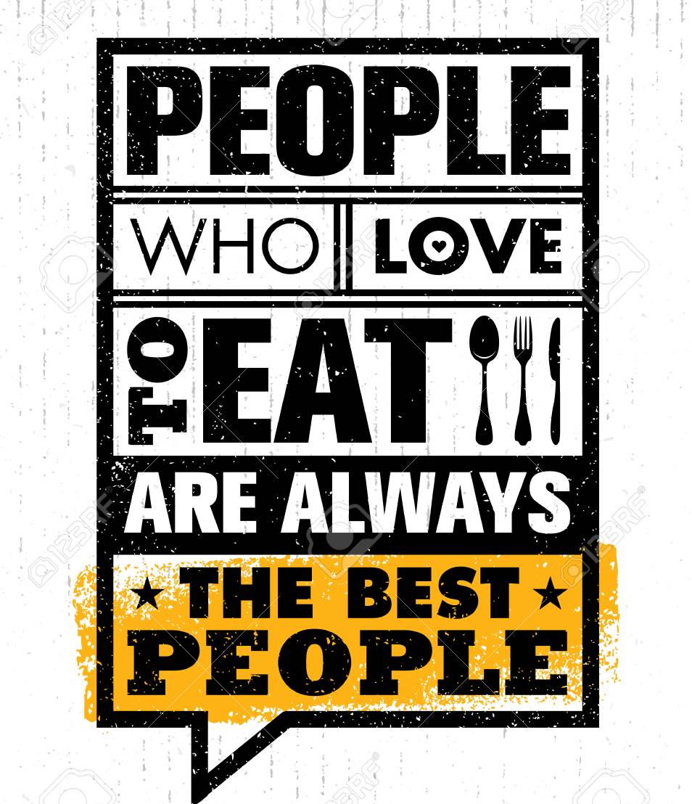
Motivation
People standing in queue and waiting for placing their orders.
People travelling long distances to go to their favourite place and enjoy the delicacies.
COVID-19 pandemic breakout resulting in red-alert zones.
Lack of cuisine-variety and people’s choice meals.

Slide 7

Objective
This project helps the customer to maintain social distancing.
This project helps to maintain time as no one will be in queue to order dishes.
This project also helps the user in predicting which food the best and which is not.

Slide 8

Scope
Modern technology was buying many new inventions in everyday life. The non-contact menu is one of the creativity used in many cafes and restaurants. The non-contact menu is based on a QR code, requires scanning qr code and you can get the full menu list on your mobile screen. When it comes to rixqr, you don't need an application. Here are the benefits of having a non-contact QR code menu: Reopening restaurants after the pandemic ensuring cleanliness and safety with non-contact menus was a very dangerous decision. In the meantime, the restaurant moved from the traditional menu to the digital QR menu to ensure the safety of the staff and users. Easily update the menu in real time
Add, delete and update the menu in real time without any work or cost. Just log in and you will be able to make the changes you want for yourself. Throw away disposable menus to improve margins without repeatedly lifting the cost of printing hard menus.

Slide 9
Some previous Related works

Slide 10
1) Restaurants need the financial relief. They face an expected drop in diners as states and cities postpone major events and crack down on dining establishments and other gathering places themselves.
Uber Eats is the latest aggregator to suspend commission from restaurants hit by the coronavirus outbreak, following in the footsteps of GrubHub Inc GRUB.N and Postmates Inc. - Reporting by Amal S in Bengaluru and Toby Sterling in Amsterdam; Editing by Vinay Dwivedi https://www.reuters.com/article/us-healthcare-coronavirus-uber-idUSKBN21333U 2) DoorDash, Inc. is an American company that operates an online food ordering and food delivery platform. It is based in San Francisco, California, United States. With a 56% market share, it is the largest food delivery company in the United States.^{[2]} It also has a 60% market share in the convenience delivery category.^{[3]} As of December 31, 2020, the platform served 450,000 merchants, 20,000,000 consumers, and 1 million deliverers. https://www.doordash.com/ https://en.wikipedia.org/wiki/DoorDash

Slide 11
What is
Heavybite ?
HeavyBite is a food ordering and delivery app designed for customer, delivery executive, restaurant panel with different functionalities that makes it easier for the food lovers to enjoy their meal within a snap of time.

Slide 12
Features
Swift login and registration
User-friendly interface
Multiple payment options
Quick order cancellation
5) No-Contact food delivery
6) Reviews and Rating (helps in identifying
People’s choice meal)

Slide 13
System actors
Customers / Users
Restaurants (Merchant)
HeavyDrivers (Drivers)
4) HeavyBite Admin

Slide 14
Functional Requirements
Customers should be able to :
Search for restaurants based on cuisine types, menus
Create cart, add menu items to cart and order
Cancel the order
Pay for the order
Create / Update account and personal information
Receive notification about status of order once placed
Track the status of order on the app

Slide 15
Functional Requirements
Restaurants should be able to :
Create their profile (onboarding) and create / refresh / add new men items, pictures
Receive notifications about orders placed, assigned HeavyDrivers, and update the status of order etc.
Off-boarding : If the restaurant goes out of business, or decides to discontinue taking online orders.

Slide 16
Functional Requirements
Heavy Drivers should be able to :
Receive notifications about the available orders in the are, from which they can choose.
Know when the order is available for pickup
Inform the customer / restaurant of any problems they encounter while executing the order pickup / delivery.
De-register in case they don’t want to continue with the job anymore

Slide 17
Tools required
SOFTWARE :
Java (Spring)
Visual Studio Code, Android Studio
Figma (UI/UX design)
ReactNative
mySQL (database)
HARDWARE :
Intel core-i3 5fth gen processor
RAM 4GB DDR4
Storage upto 10 GB

Slide 18
Data flow diagrams

Slide 19
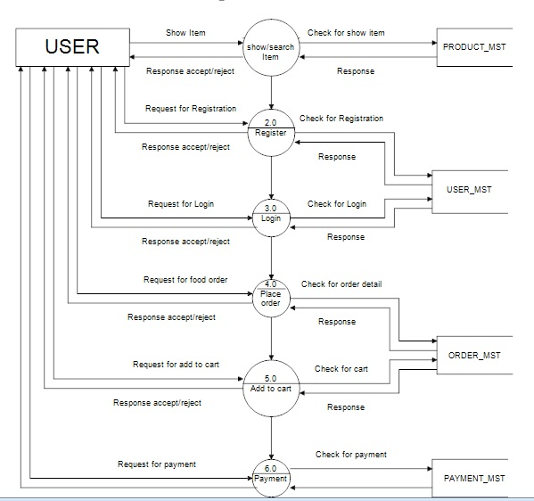
Level - 1

Slide 20
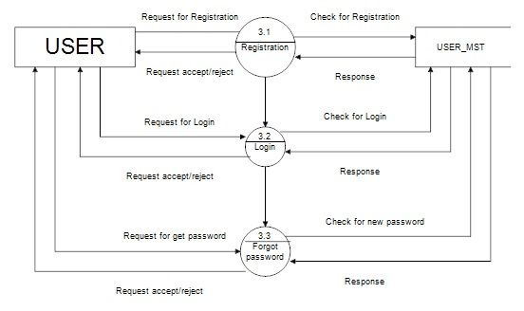
Level - 2

Slide 21
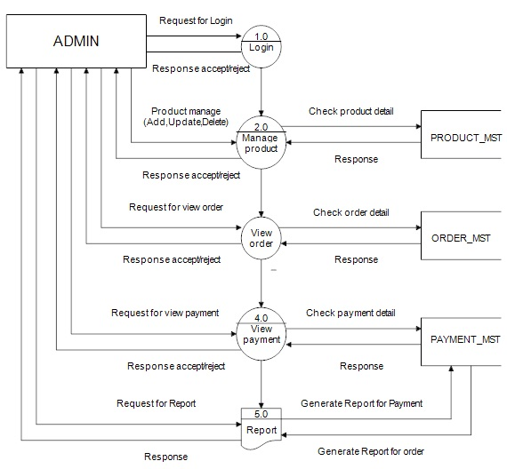
Admin
Side

Slide 22
Gantt chart

Slide 23
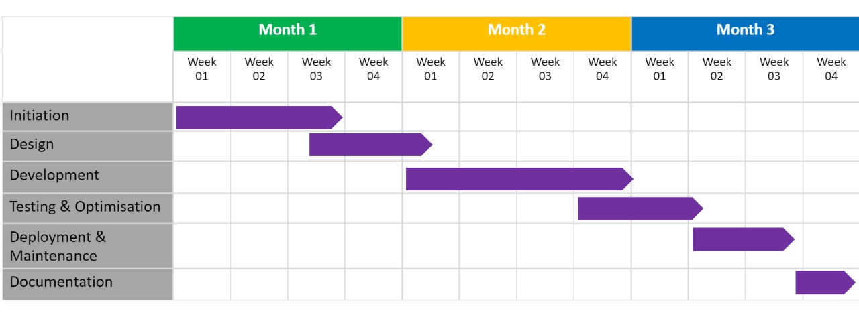

Slide 24
References
https://en.wikipedia.org/wiki/DoorDash
https://medium.com/partha-pratim-sanyal/system-design-doordash-a-prepared-food-delivery-service-bf44093388e2
https://www.mindinventory.com/blog/food-delivery-mobile-app-business-common-challenges-and-solutions/
https://www.koreascience.or.kr/article/JAKO201711656710338.pdf
https://existek.com/blog/food-delivery-app-development-features-and-cost/#examples_of_food_ordering_apps
https://www.appdupe.com/swiggy-clone-script#app-demo

Slide 25
Thank You

Slide 26

Question & Answer Time

